Slide 1


Securing APIs: Risks and solutions for Weak Authentication
This presentation explores the critical risks associated with weak API authentication and offers practical solutions to mitigate these vulnerabilities. APIs are essential for modern applications, but their security is paramount. We will delve into common authentication flaws, demonstrate potential exploits, and propose effective mechanisms to safeguard your APIs.
by Saradareddy Karumuru
AP22110010389

Slide 2

Introduction to APIs and Authentication
APIs (Application Programming Interfaces) are a core part of modern web and mobile applications, enabling systems to interact and share data. However, APIs are prime targets for attackers, especially when authentication is weak or misconfigured. This project explores the risks of weak API authentication and proposes practical solutions using modern techniques.
Core Component
Prime Targets
APIs are essential for modern applications.
APIs are often targeted by attackers.
Security Risks
Weak authentication poses significant risks.

Slide 3




Types of API Authentication
Basic Auth
API Key
1
2
Username/password in base64, insecure.
Simple static token, easy to steal.
JWT
OAuth 2.0
4
3
Self-contained, digitally signed tokens.
Token-based, used by Google, Facebook.
API authentication methods range from simple API keys to more secure options like OAuth 2.0 and JWT. Each method has its own strengths and weaknesses, and the choice depends on the specific security requirements of the API.

Slide 4
Problem Identification: Widespread API Vulnerabilities
Lack of Proper Authentication
Vulnerability to Attacks
Many publicly available APIs lack adequate authentication mechanisms or rely on outdated methods, exposing them to significant security threats.
APIs without robust authentication are susceptible to data theft, impersonation, service abuse, and data manipulation.
This lack of robust authentication represents a critical security concern, especially in systems handling user data, financial transactions, or sensitive organizational information. Addressing this issue is essential to ensure the integrity, confidentiality, and availability of services that depend on APIs.

Slide 5

Objective: Mitigating Risks of Unauthenticated APIs
1
Demonstrate Exploitation
2
Implement Authentication
Illustrate how APIs without proper authentication can be exploited through real-world attack scenarios.
Propose and implement a basic authentication mechanism using API keys, token-based authentication, or credential verification.
3
Highlight Improvements
Evaluate security improvements by comparing unauthorized access attempts before and after implementation.

Slide 6





Tool Setup and Project File Creation
Python
Flask
Postman
Text Editor
The project utilizes Python, Flask (a lightweight web framework), Postman (for testing), and a text editor. A new Python file, api_demo.py, is created with code to define public and secure data routes, protected by a basic hardcoded token.

Slide 7
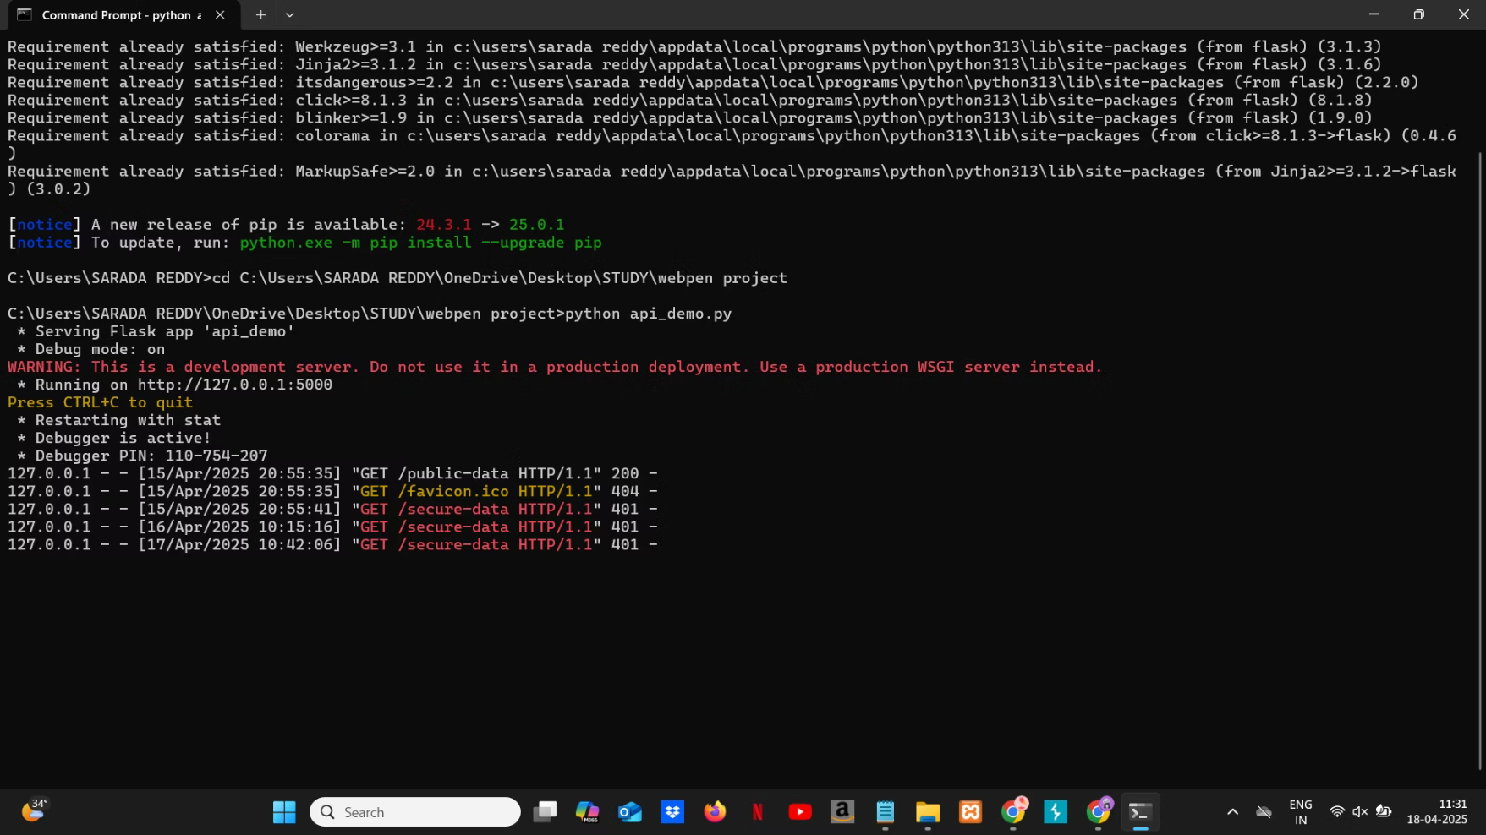

Slide 8
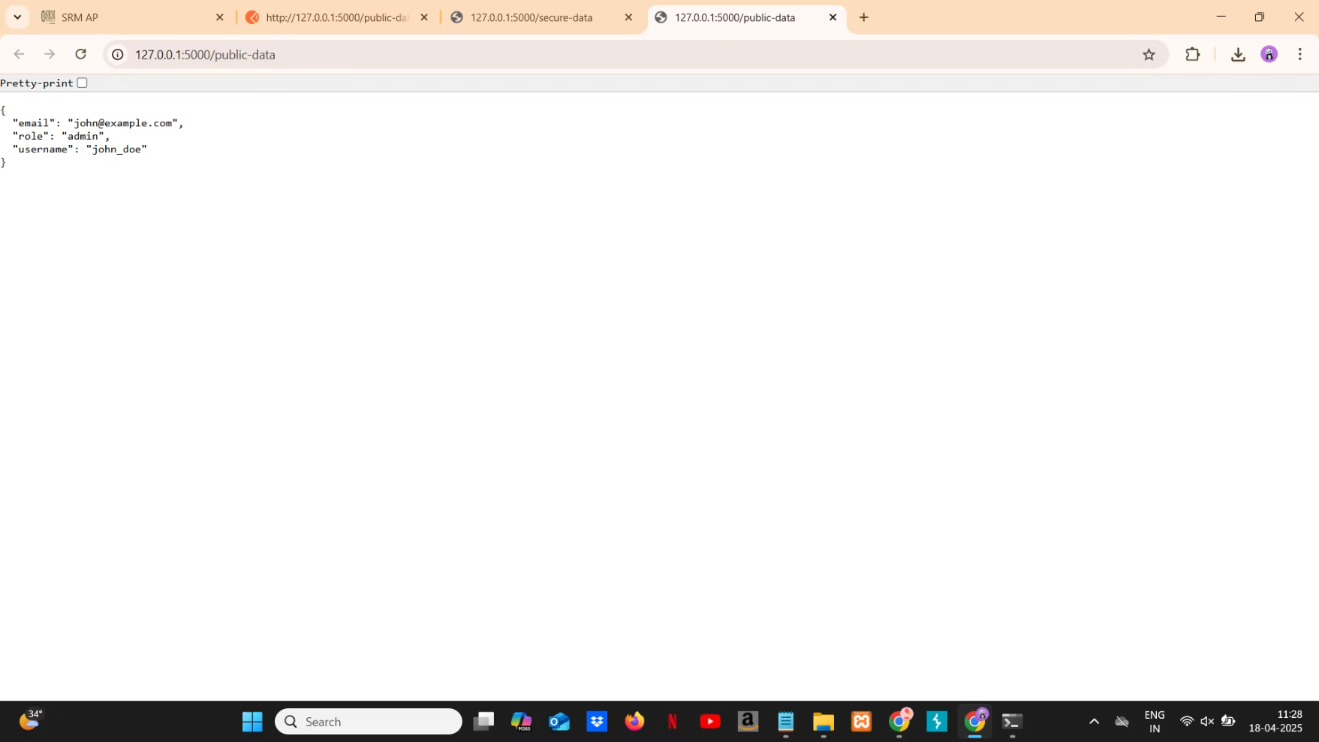

Slide 9
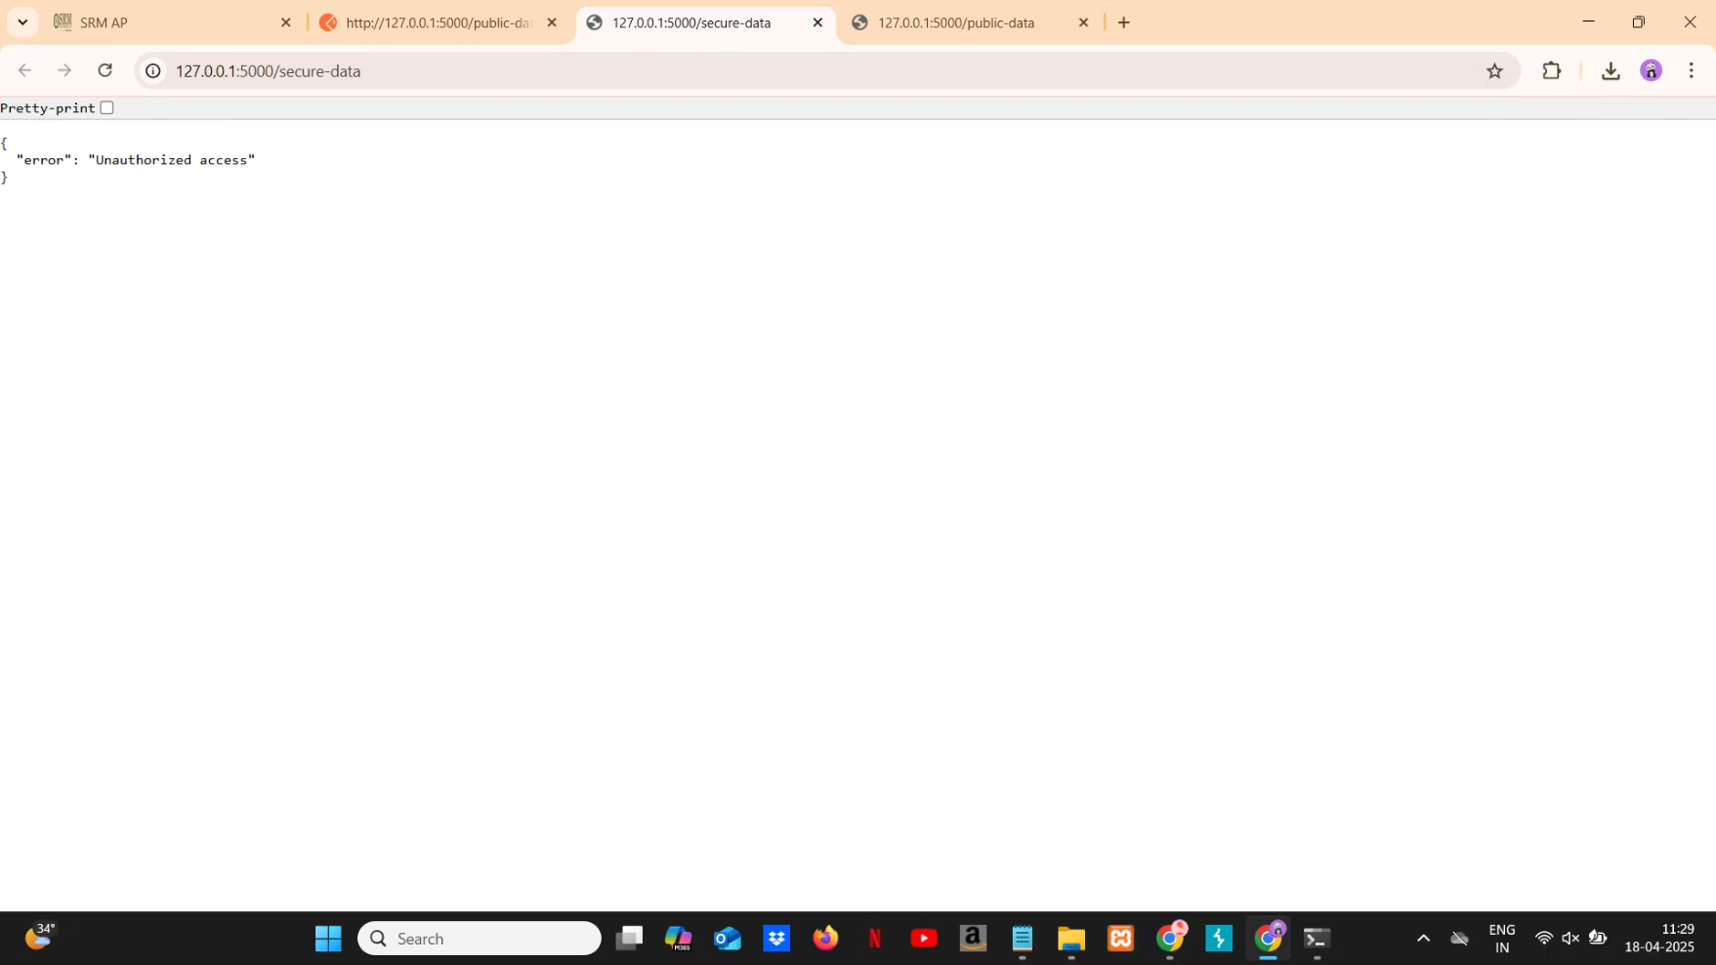

Slide 10
Running the API and Risks of Weak Authentication
Unauthorized Access
1
Attackers gain access to sensitive data.
Data Breaches
2
Exposed user data violates privacy laws.
Account Takeovers
3
Hijacked user sessions.
The server starts running locally. Weak API authentication leads to unauthorized access, data breaches, account takeovers, API abuse, privilege escalation, and replay attacks. It's crucial to implement robust security measures to protect APIs from these threats.

Slide 11
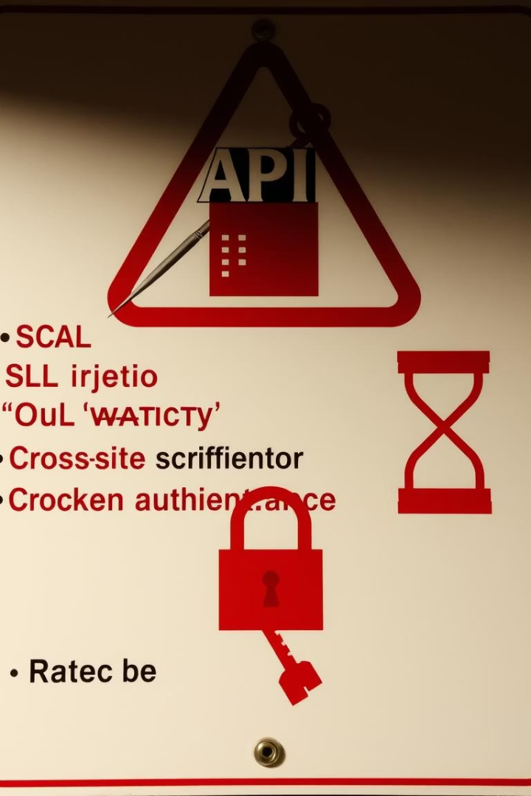




Risks of Weak API Authentication (Detailed)
Unauthorized Access
Access to sensitive endpoints.
Data Breaches
Exposed user data.
Replay Attacks
Resending old API requests.
Token Theft
Stolen static tokens.
Weak API authentication mechanisms expose APIs to various risks, including unauthorized access, data breaches, replay attacks, token theft, and account takeover. These vulnerabilities can lead to significant security incidents and regulatory penalties.

Slide 12
Proposed Solutions for API Security
OAuth 2.0
HTTPS
Strong Auth
Secure Transport
Use OAuth 2.0 or JWT.
Always use HTTPS.
Short
Flask-Limiter
Token Expiry
Rate Limiting
Set short token lifetimes.
Avoid brute-force attacks.
To enhance API security, it's essential to use strong authentication methods like OAuth 2.0 or JWT, ensure secure transport with HTTPS, implement token expiry and rotation, validate input, apply rate limiting, and maintain logging and monitoring.

Slide 13



Conclusion: Securing Your APIs
By understanding the risks of weak API authentication and implementing robust security measures, you can protect your APIs from potential attacks and ensure the integrity, confidentiality, and availability of your services. Use strong authentication, secure transport, token management, input validation, and monitoring to safeguard your APIs.
1
Monitoring
2
Validation
3
Token Mgmt

